Slide 1
UoE Online Object-Oriented Information Systems
SEMINAR 2: PYTHON PROGRAMMING

Slide 2
Classes and Object: Challenge
This challenge will make some changes to the previous challenge. You will make use of your knowledge of classes, in addition to looping and lists. Lists can store objects so this challenge will require you to create a list of Person objects, that you will instantiate and add to the list.
In this challenge, you will create five (5) Person objects with appropriate values for first name, last name, weight, and height.
For this exercise, you can use the names p1, p2, p3, etc. for the names of your instantiated objects.
Once you have all five objects, create a list and store the objects in the list. Recall, an object is simply an instance of a user-defined type, so the syntax is the same as adding any other variable to a list.
Using a for loop, iterate over your list and print out the first names of each of your Person objects that you created. The output should look something like this:
Tom Fred George Tanya Mary
Step 4 will require you to think about how you will access each member of the list and then how to access the correct attribute of that object to output it with a print statement

Slide 3
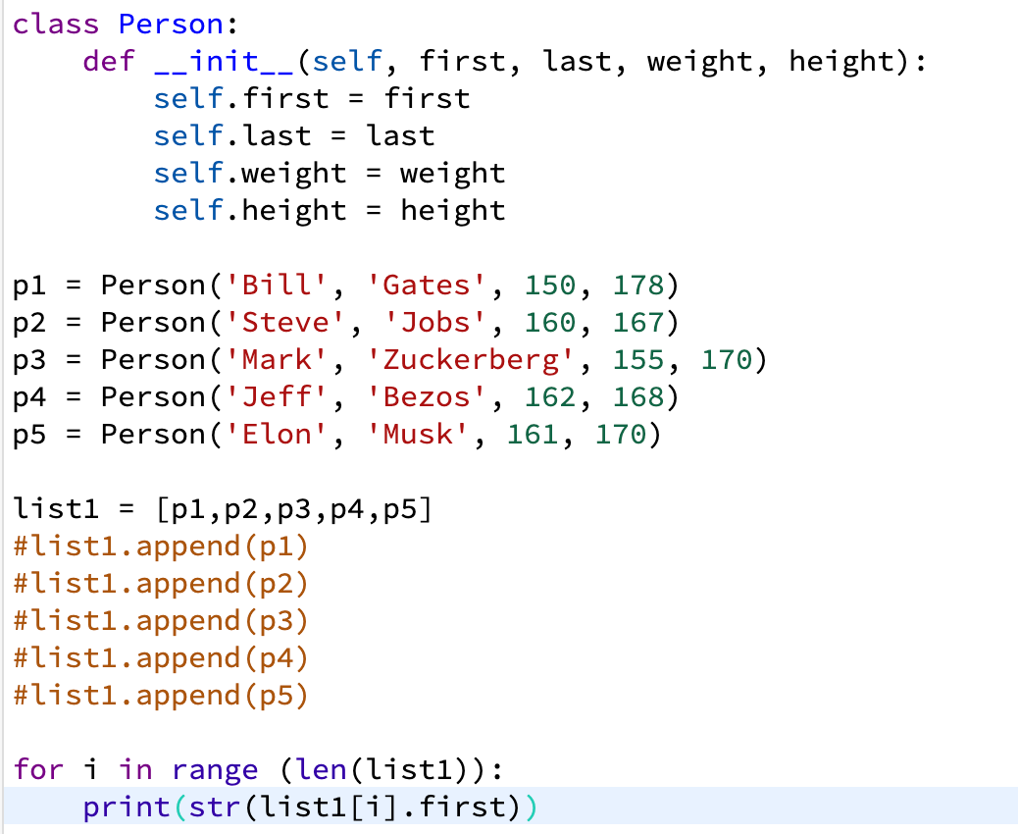
Code

Slide 4
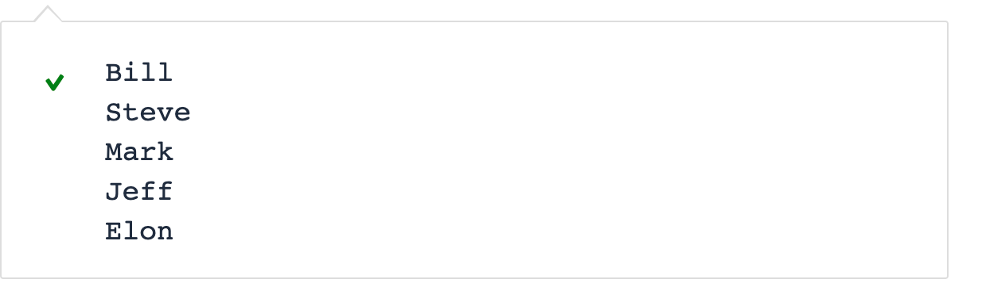
Output

Slide 5
Classes and Functions: Challenge
Ok, we have given you some guidance and practice creating and using methods in your classes, both as instance methods and as static methods. In this challenge, you will add on to your Person class by building in some additional functionality.
Add an instance method called print_self() that, when called, will output the instance object’s first name, last name, weight, height, and BMI. Call that method and validate the output is correct for each object instance you create.
Create another method in your Person class that returns a value indicating if the person is underweight, good weight, or overweight, according to the CDC ranges. You already have the ranges available to you from previous labs. Call this method to output the result. HINT: You will need to make a method call inside a method call for this to function because we are not storing the BMI value in our Person class.

Slide 6
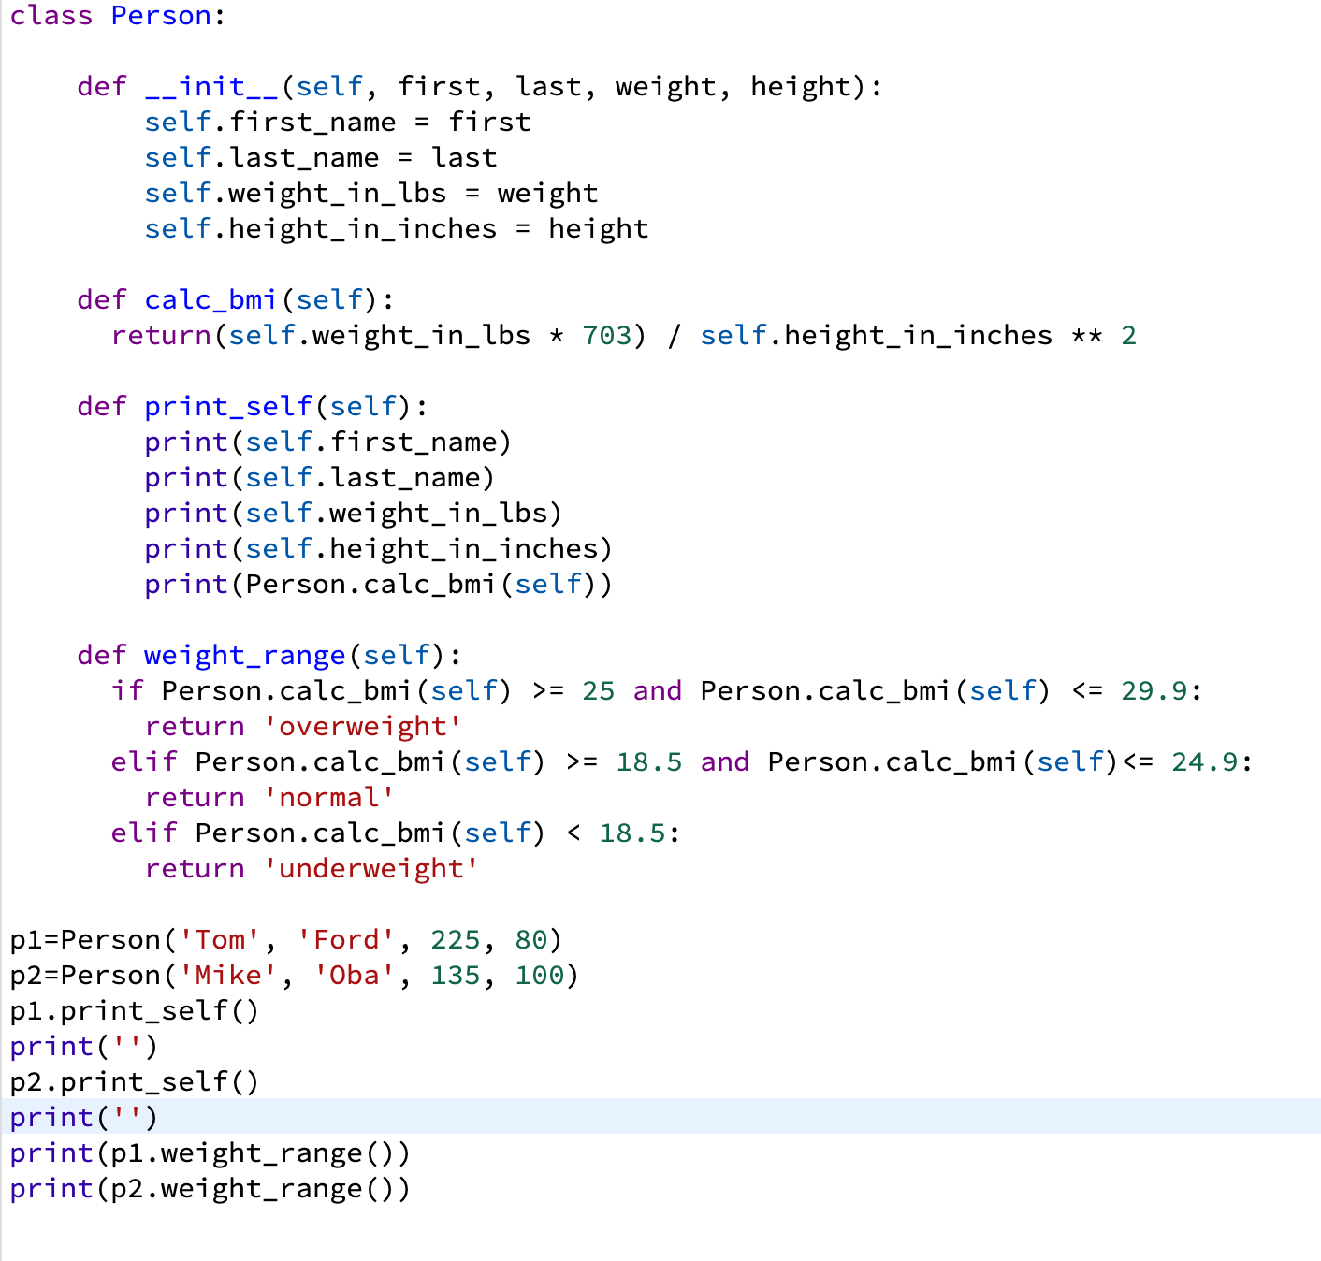
Code

Slide 7
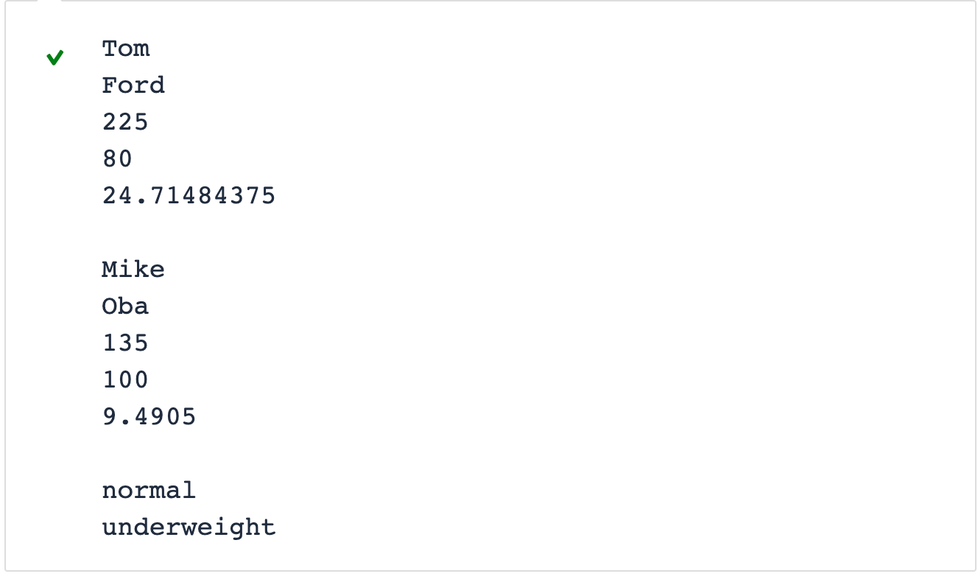
Output

Slide 8
Inheritance: Challenge
For this hackathon, explore inheritance further by completing the following tasks:
Create a new class called Teacher that inherits from Adult. Provide additional attributes around teacher type (such as kindergarten, secondary, or higher education) and BMI risk factor (kindergarten = 1, secondary = 2, and higher ed = 3). Assign BMI risk factors in the initializer based on the type of teacher that is supplied when creating the object.

Slide 9
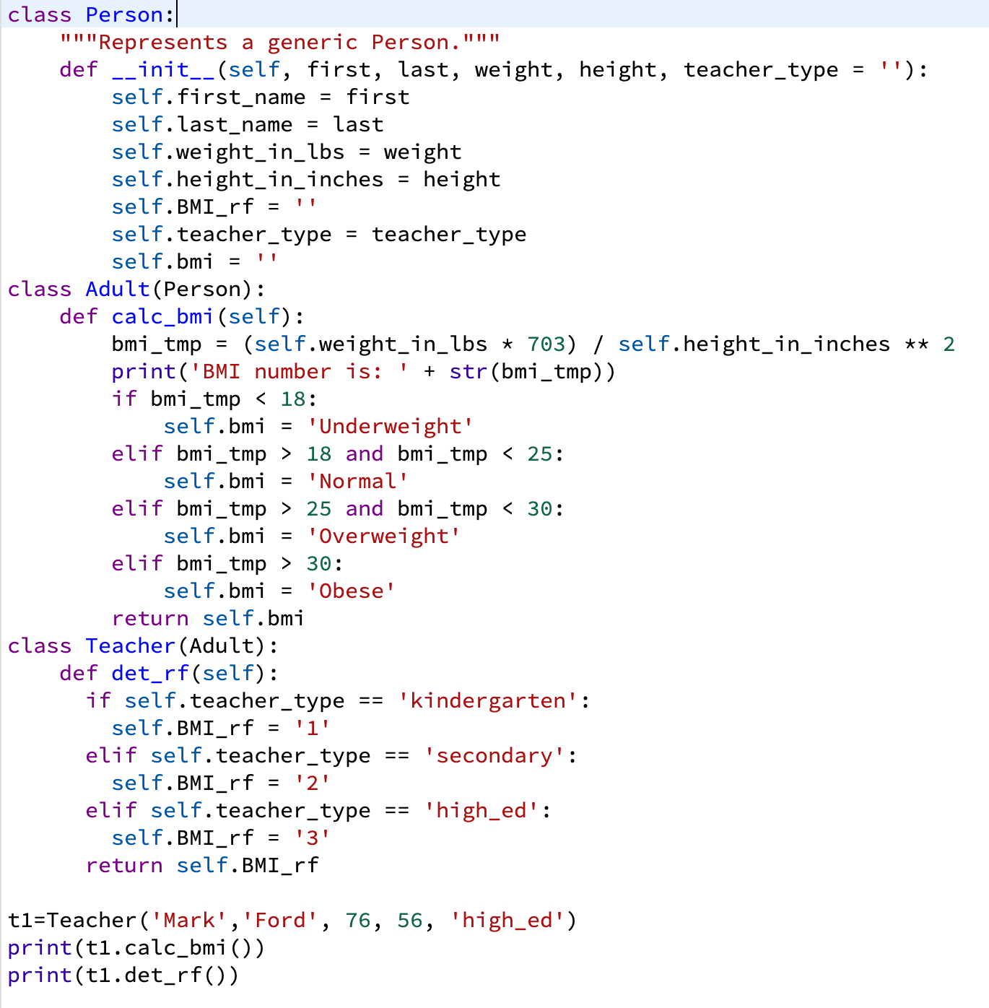
Inheritance: Code

Slide 10
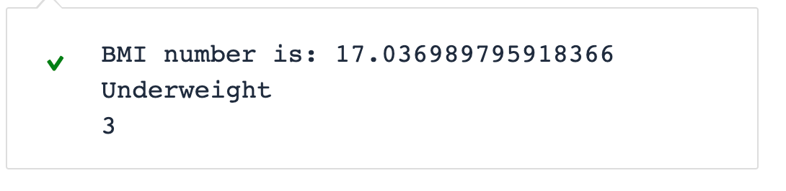
Inheritance: Output

